Slide 1
Chuanzhao Huang's homepage
Project 1: Web Development Course
Northeastern University

Slide 2
Objective
To build a personal website to introducing myself, my hobbies and my homepage.

Slide 3
Technologies used
VS Code
Bootstrap
Smooth Scroll

Slide 4

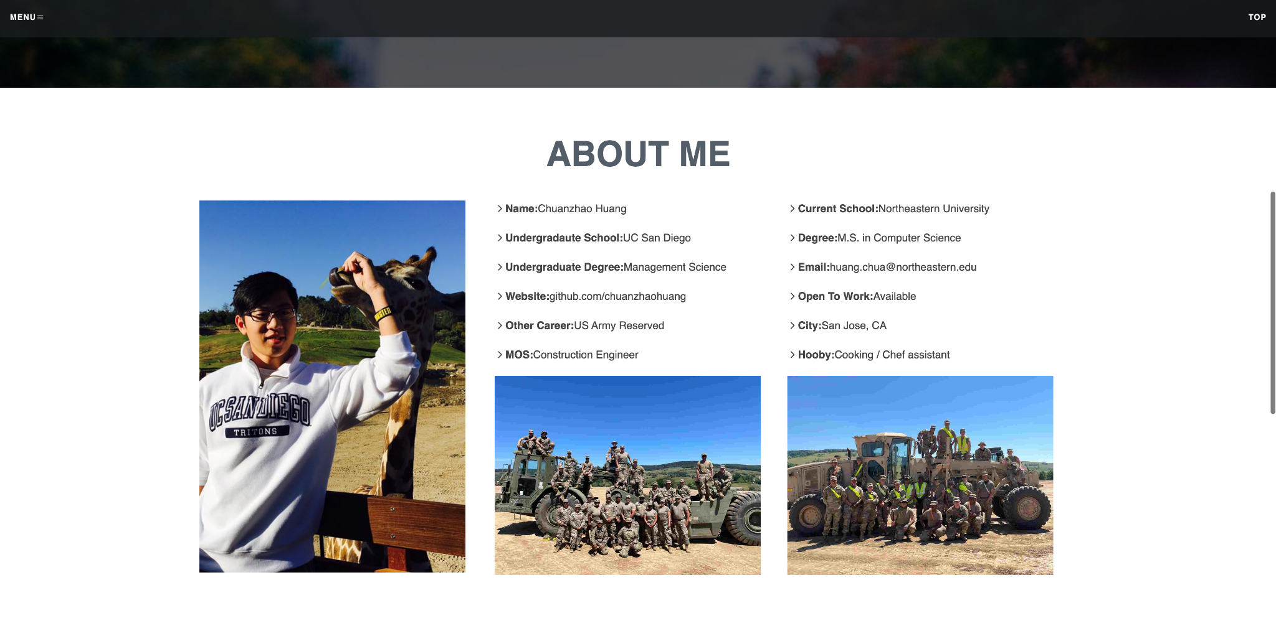
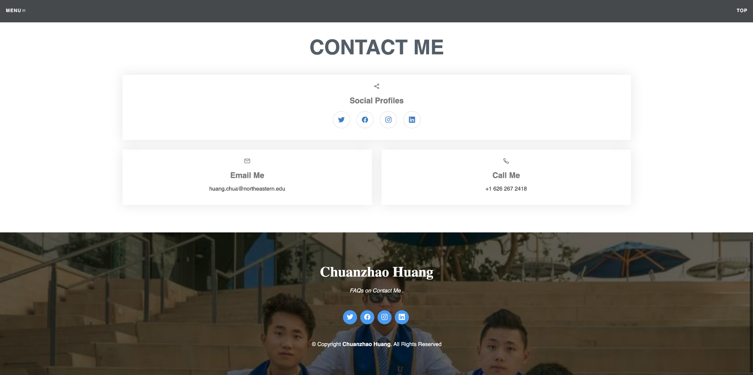
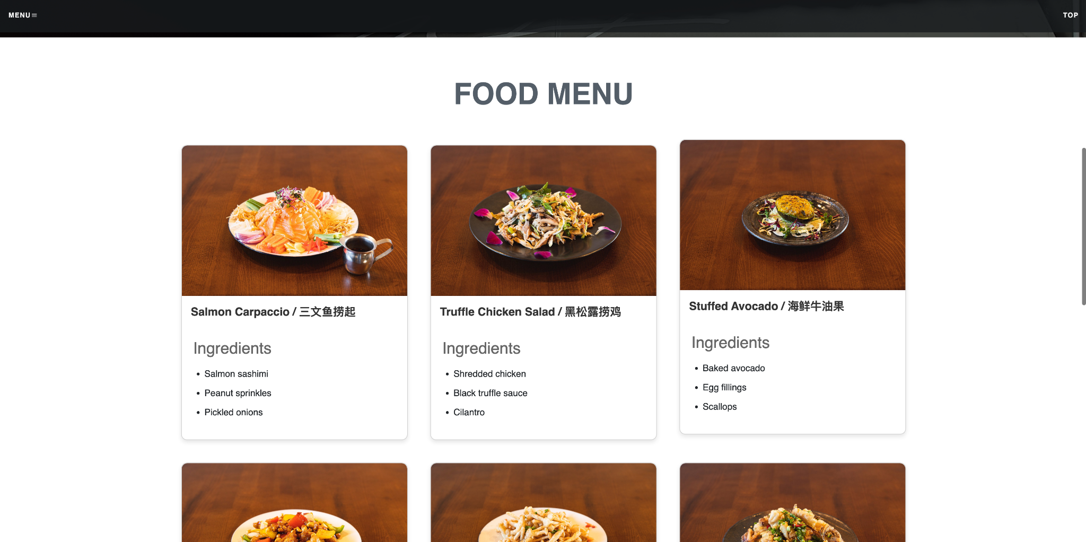
What I'm proud of

Slide 5
What I struggled the most with
HTML: <div>, class=“ ”, … etc
CSS: font-size, margin, size, … etc
JS: function, addEventListener, … etc
Github Upload

Slide 6

Demo

